Slide 1


Slide 2


NextGen Logistics: Digital Transformation
Second Year Project Synopsis
Submitted by
ROLL | NAME
2301730325 | Amit Mohanty
Industry Mentor: Mr. Biswaranjan Mohapatra
Faculty Mentor: Dr. Tanu Gupta
Notes:
New Courses replaced with New Programmes

Slide 3

Project Overview
In the present fast-paced logistics sector, digital solutions will provide more efficiency, transparency, and satisfaction to the client. Prime Express, a logistics service provider, would like to upgrade its online solution by incorporating key features that streamline shipping processes and enhance customer experience
This project is aimed at integrating real-time tracking of shipments, a shipping rate calculator, an order management dashboard, and a chatbot for customer assistance to the existing Prime Express website. This enhancement will allow customers to have immediate access to shipping information, getting estimates on costs, tracking their orders, and controlling automated assistance in that order, with the goal of optimizing the logistics workflow.
The project will seek to improve operational efficiency, minimize manual workload, and increase service quality through the introduction of a few web technologies and automation already available. This report will elaborate on the implementation of what is expected, the benefits and effects of these additions on the business and its customer.
Notes:
New Courses replaced with New Programmes

Slide 4
About the Problem
Inability in Real-Time Visibility: Current systems have no real-time tracking feature, bringing about uncertainties in knowing the status of the shipment.
Cost Estimation is Manual: Users find it extremely tedious, as they need to call customer support before she can have any estimation or quote of rates.
Speed of Order Fulfillment: Customers can't track their shipments from a centralized dashboard or make changes on it.
Absenteeism in Customer Support: Lack of an AI-backed chatbot delays the process of answering customer inquiries.
With the integration of such digital solutions, Prime Express will be on the verge, not on the way to closing these gaps, to provide a more excellent and efficient logistics experience..
Notes:
New Courses replaced with New Programmes

Slide 5
Problem Statement
Traditional logistics websites struggle with real-time shipment visibility and manually calculating prices, order handling in different stands, and slow customer support, causing customer dissatisfaction and inefficiencies. This project aims to digitally transform logistics operations by integrating real-time tracking, automated rate calculations, an order management dashboard, and AI-powered customer support. Addressing these points will enhance operative efficiency, allowing for cost cuts and improved customer satisfaction by seamlessly providing transparency, faster response times, and reliability. This transformation is imperative in order to remain competitive and improve service quality dramatically.
Notes:
New Courses replaced with New Programmes

Slide 6
Objectives
Real-Time Shipment Tracking
GPS-based tracking for a live view of the shipment status.
Automated Rate Calculator
Automatic rate quotations available instantly on entering shipment details.
Enhanced Order Management Dashboard
Streamline order diagnostic and management through one dashboard.
AI-Powered Chatbot
Automated customer support 24/7 for quick response times.
Notes:
New Courses replaced with New Programmes

Slide 7
Methodology, Tools, and Techniques
Frontend : HTML,CSS,JavaScript(Vanilla JS)
Backend: Python (Flask/)
Database: CSV Files
Data Processing: Excel,Matplotlib,Pandas,
Location Tracking: Leaflet.js and GPS
Visualization: Matplotlib,seaborn
Notes:
New Courses replaced with New Programmes

Slide 8
Results & Impact
AI powered chatbot will help customers with their qweries 24/7.
Real–Time shipment tracking will help to customer to find the exact location pf their package.
Rate calculator will allow customer to calculate the pricing for their quote based on the distance weight and delivery speed.
Order management dashboard will help customers to manage their order efficiently.
This will help in overall customer satisfaction.
And this will increase business efficiency.
Notes:
New Courses replaced with New Programmes

Slide 9
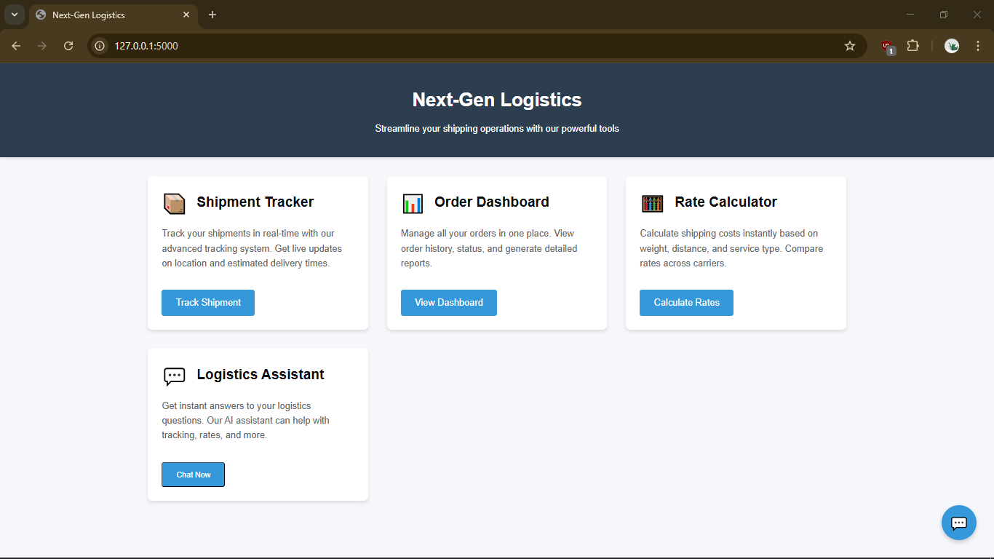
Home page

Slide 10
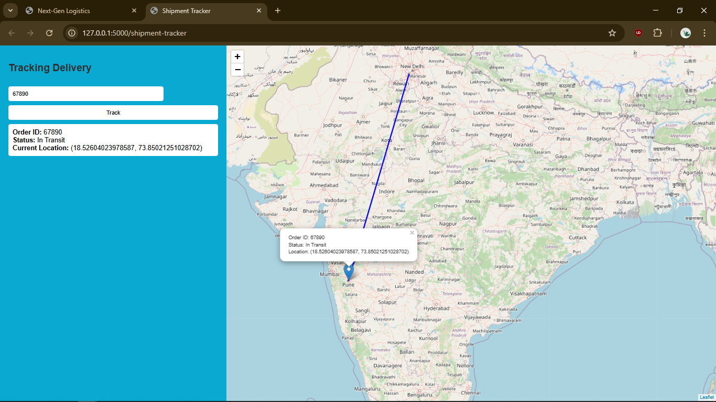
Shipment tracker

Slide 11
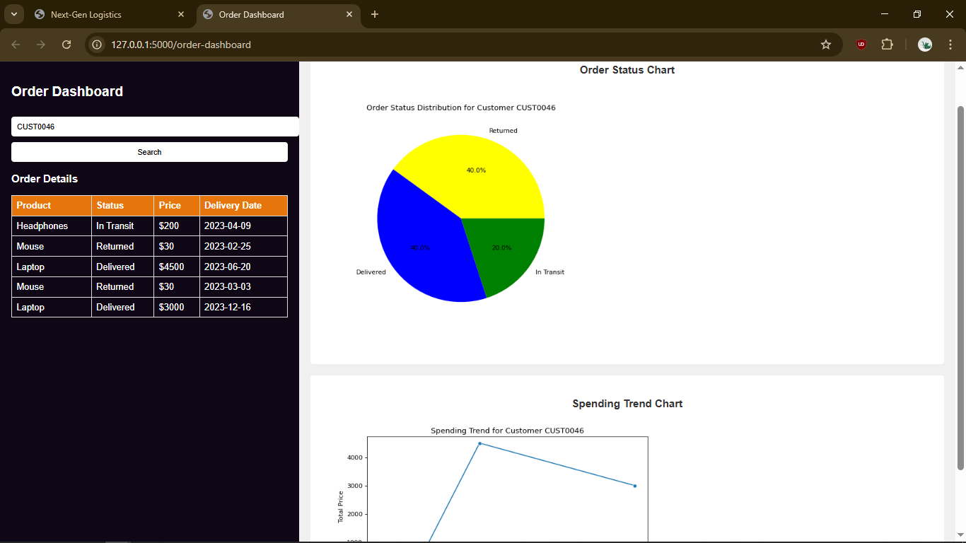
Order Management Dashboard

Slide 12
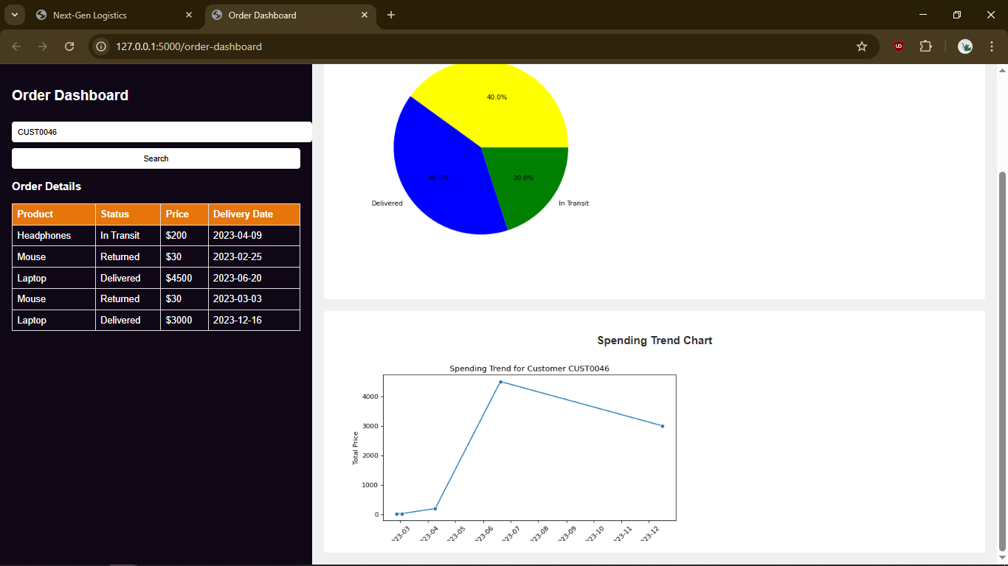

Slide 13
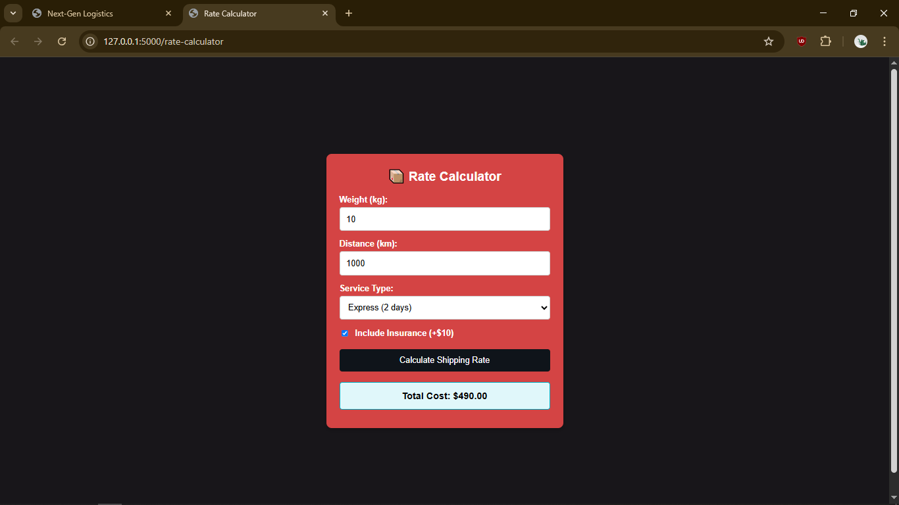
Rate Calculator

Slide 14
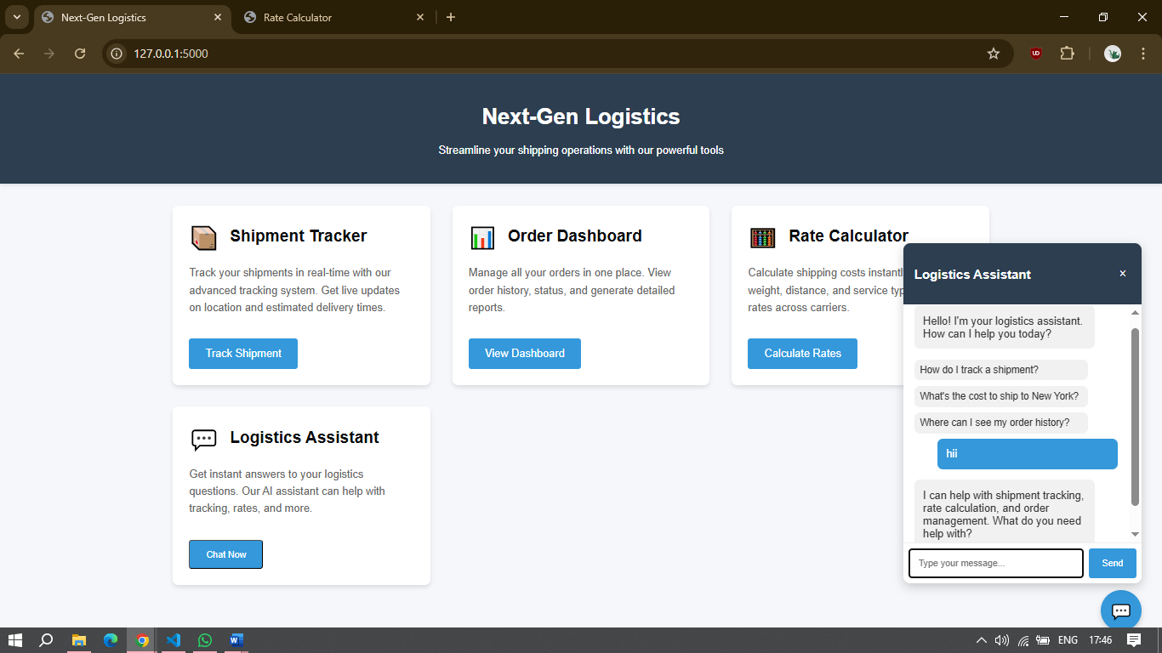
AI Chatbot

Slide 16
THANK YOU
THANK YOU

